Slide 1

1
PORTFOLIO
Hi, I’m Marvel.
I build AI systems that move from research into real-world decisions.
I’m a final-year Data Science student at Bina Nusantara University and an AI Solution Architect at Philip Morris International. My work runs from sign-language recognition and healthcare AI to mental-health screening and recommendation systems — research I try to push all the way to something a person can actually use.
3.74
07
GPA • BSC DATA SCIENCE, BINUS
PUBLICATIONS • 1 UNDER REVIEW
I’m applying to the Academy because the hardest part of my work isn’t the model — it’s everything after it. I want to learn to turn what I build into products that feel intuitive, accessible, and worth using.
0.3%
05
TOP OF 6,600+ APPLICANTS (PMI)
NATIONAL AWARDS & DELEGATIONS
05
Selected work
PROJECTS
@marvelm69
marvel.m818@gmail.com
marvel-portfolio-two.vercel.app

Slide 2
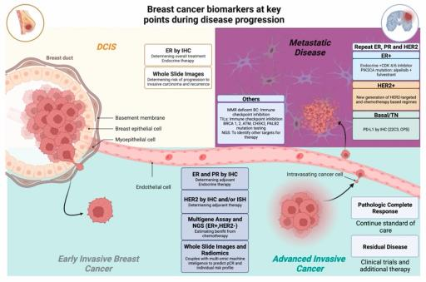
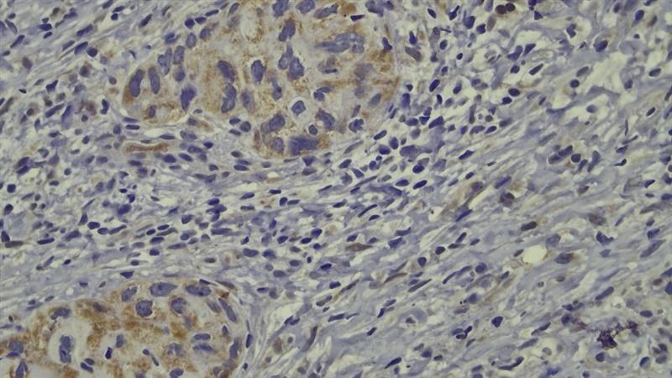
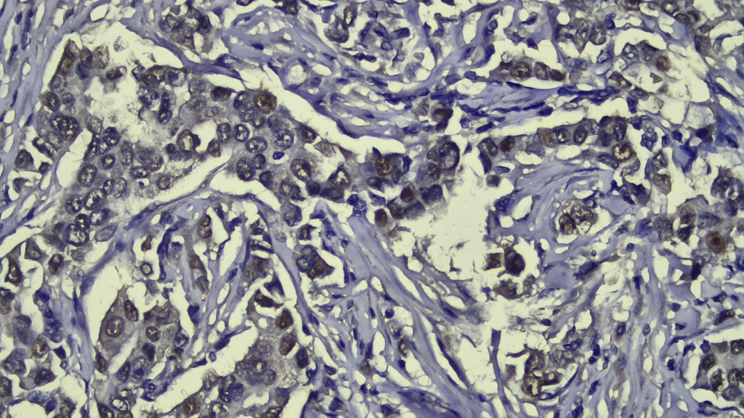
01
2
Real-time breast-cancer IHC intelligence
GROUP RESEARCH
ROLE • ALGORITHM & APPLICATION DEVELOPER
DESCRIPTION
A multimodal ensemble system designed to determine immunohistochemical profiles and support downstream subtype, prognosis, and therapy-oriented decisions in real time.
23,154
99.7%
IHC IMAGES • TWO TERTIARY HOSPITALS
UP TO ACCURACY
99.4%
REAL-TIME
ROC–AUC
MICROSCOPE → DISPLAY SETUP
POSITIVE
NEGATIVE
IMPACT
A clinically oriented end-to-end prototype that keeps workflow and inference latency in view — not just offline model scores.
WHAT I LEARNED
A technically strong model is only useful when it fits the environment, decision flow, and people around it.
@marvelm69
marvel.m818@gmail.com
marvel-portfolio-two.vercel.app

Slide 3
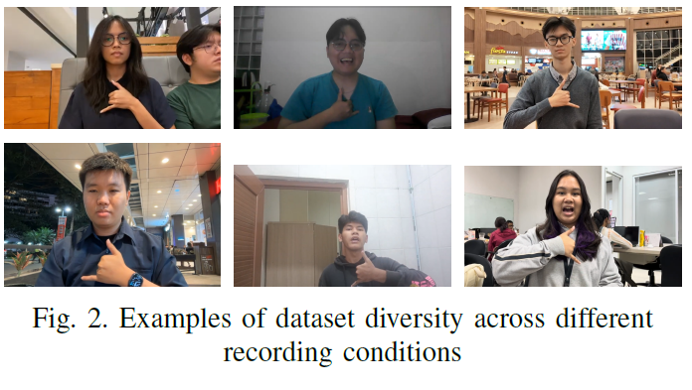
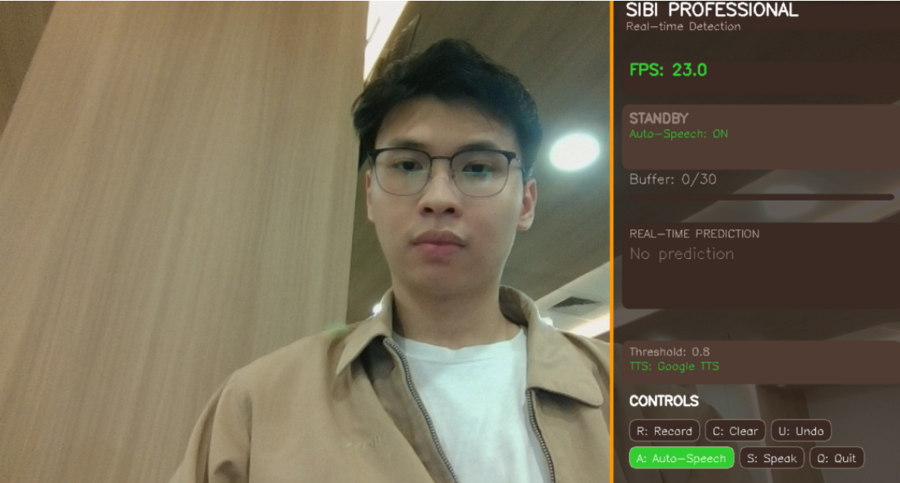
02
3
Recognizing SIBI words from video — in real time
THESIS-LED COLLABORATIVE PUBLICATION
ROLE • LEAD RESEARCHER
DESCRIPTION
This research compares 3D CNN and CNN–LSTM architectures for word-level Indonesian Sign Language (SIBI) recognition from video, then brings the better-performing model into a real-time prototype.
> .95
2.70 ms
CNN–LSTM ACCURACY & F1
CNN–LSTM INFERENCE / FRAME
IMPACT
Moved beyond alphabet/static-image recognition toward words used in formal and academic contexts, with real-hardware evaluation.
WHAT I LEARNED
The “best” architecture depends on the experience you are trying to create. Accuracy, latency, hardware, and accessibility must be designed together.
↗ GitHub
@marvelm69
marvel.m818@gmail.com
marvel-portfolio-two.vercel.app

Slide 4
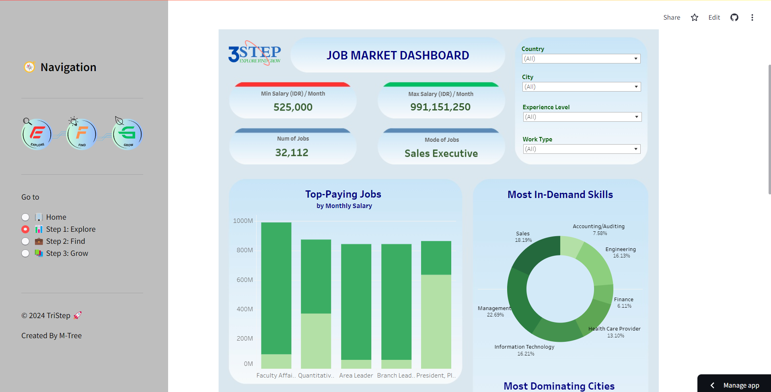
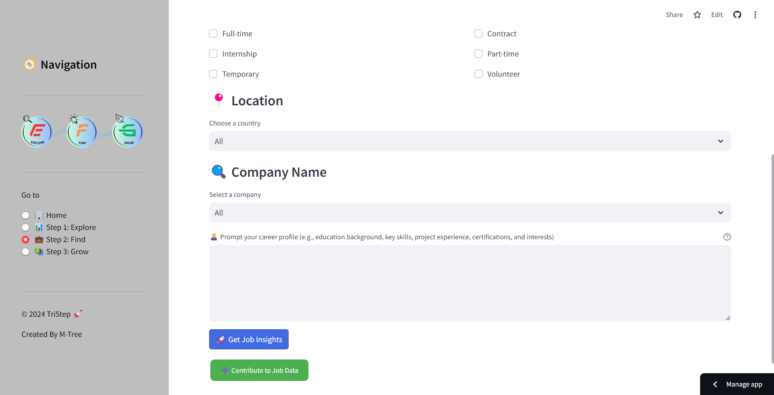
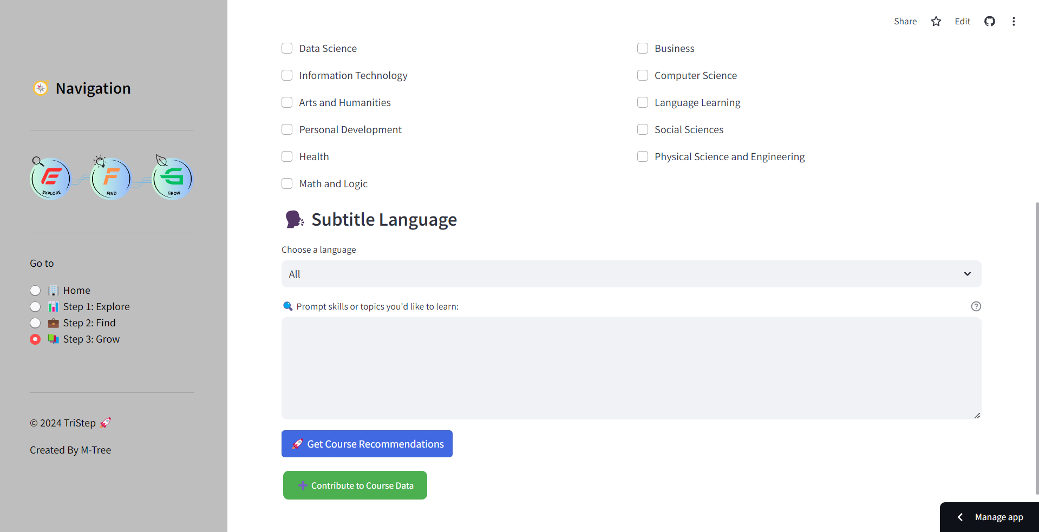
03
4
TRISTEP — Explore. Find. Grow.
GROUP PROJECT
ROLE • PRODUCT DEVELOPER
DESCRIPTION
An AI-powered career-development platform that helps users understand the market, discover relevant job opportunities, and identify courses that close skill gaps.
IMPACT
Built an end-to-end recommendation experience that connected data, ML evaluation, product flow, and a working Streamlit deployment.
WHAT I LEARNED
A simpler model can be the better product decision. TF–IDF beat more complex approaches here while offering strong accuracy, speed, and easier iteration.
↗ GitHub
Model evaluation
TF–IDF
Prec@10 0.846 jobs / 0.836 courses
@marvelm69
marvel.m818@gmail.com
marvel-portfolio-two.vercel.app

Slide 5
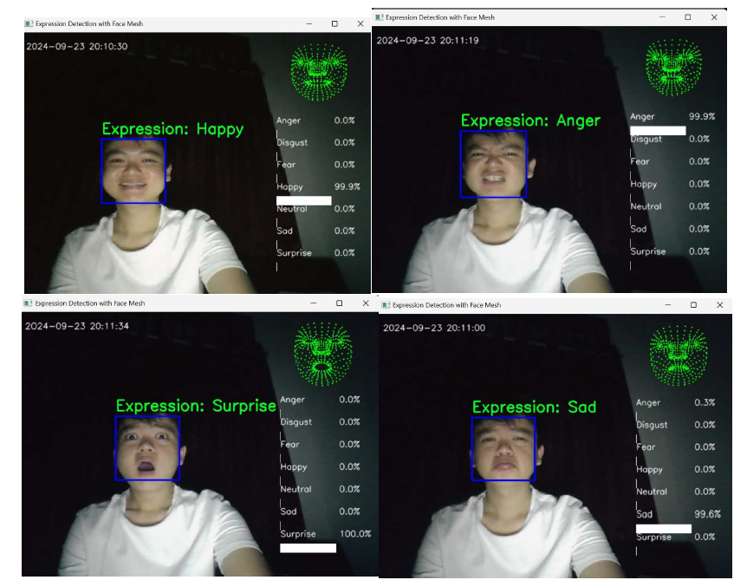
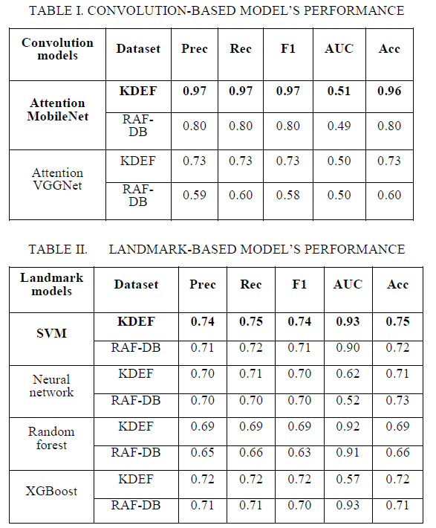
04
5
Facial-expression recognition for service contexts
GROUP RESEARCH
ROLE • ALGORITHM DEVELOPER
DESCRIPTION
This work compares deep-learning and landmark-based approaches for real-time facial-expression recognition, exploring how computer vision might support more efficient service-quality evaluation.
0.97
0.93
MOBILENET F1
LANDMARK SVM AUC
IMPACT
Demonstrated two viable real-time approaches with different strengths: headline recognition performance versus robustness on landmark features.
WHAT I LEARNED
Human-behavior AI needs careful interpretation. A model should support judgment, not turn a noisy signal into an unquestioned score.
@marvelm69
marvel.m818@gmail.com
marvel-portfolio-two.vercel.app

Slide 6
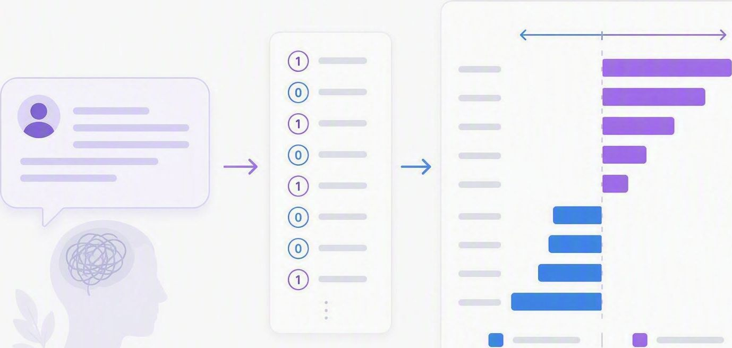
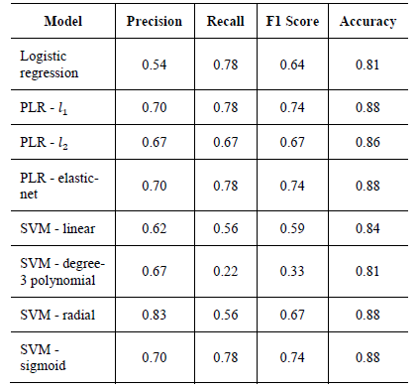
05
6
Detecting bipolar disorder from free-text symptoms
GROUP RESEARCH
ROLE • LEAD RESEARCHER
DESCRIPTION
A published study (ICCSCI 2024, Procedia Computer Science) that screens for bipolar disorder from crowdsourced free-text symptom reports, turning everyday descriptions of symptoms into features a model can learn from.
IMPACT
Best models reach 0.88 accuracy and 0.74 F1 (precision 0.70, recall 0.78), and SHAP surfaces the symptoms behind each prediction — built for an initial screening step, not a black box.
WHAT I’M LEARNING
In mental-health AI, explainability is part of the result. A screening model is only useful if a clinician can see why it reached its conclusion.
@marvelm69
marvel.m818@gmail.com
marvel-portfolio-two.vercel.app

Slide 7
7
WHY THE ACADEMY
I want to become better at the part after the model works.
Across these five projects the pattern is the same: I enjoy the technical problem, but the work only feels finished when someone outside the notebook can use it. Closing that gap — between a model that scores well and a product people trust — is why I’m here.
01
02
03
BUILD
DESIGN
COLLABORATE
Take my research past notebooks and demos into real apps — stronger software, mobile, and Swift engineering.
Turn predictions, uncertainty, and clinical or financial workflows into interfaces that feel clear and calm.
Keep building across disciplines — as I have with clinicians, regulators, and researchers — with designers and developers too.
From models that predict → products people can trust.
↗ GitHub
↗ Portfolio
↗ LinkedIn
@marvelm69
marvel.m818@gmail.com
marvel-portfolio-two.vercel.app

